Slide 1
Presentation of the company
May 2025

Slide 2
Our purpose is to support leaders and future leaders to do well & good
Do Well
Do Good
“performance”
“impact”
Create long-term value for shareholders
Improve efficiency of organisations
Attract and grow talent
Foster innovation
Find the balance between impact and performance, to create an economy that works for all and for the planet
Create long-term value for society
Have a positive social impact
Preserve the planet
Reduce inequalities
Notes:
foster sustainable growth
Every leader can cultivate a strong purpose for their organizations and allow progress to individuals and society to progress, they do well for the world and for themselves, it is a responsibility we embrace to train Do Well Do Good leaders
it becomes a responsibility we wholeheartedly embrace in shaping Do Well Do Good leaders
We help our clients to become the best in their field with high quality advisory and expertise
We accelerate our client companies’ decision-making processes by providing efficient advice and meet their need to face challenges
We foster innovative ideas and creative strategies to keep our clients ahead of competitiveness

Slide 3
We deliver our purpose that through 3 interlinked businesses
Strategic Consulting
Education
Ventures
Advise companies and organizations to find the balance between performance and impact
Shape a future generation of leaders who will embrace careers that balance impact and performance
Advise and support entrepreneurs to embed Do Well Do Principles since day 1
Deliver high quality advisory, with former top management consulting firm employees, at a competitive price
Bring functional expertise on Do Well Do Good topics (e.g., climate, circular economy) and industry expertise on our sectors (e.g., Energy, Mobility, Construction)
Bring our Do Well Do Good values, to define purpose, align governance and leadership with long-term projects of organizations
In-person student programs sponsored by corporate partners: talented students, trained by consultants for 12 months, with a 6-month internship at a sponsor’s strategy department service
Hybrid student programs: Future Leaders program turns bright university students worldwide into DWDG leaders, by a series of intensive training, workshop, imbibed of corporate and leadership skills on real projects
Executive education: Tailored program and activities for leaders to trigger a societal transformation from within their organizations
Financing: Within our education programs, we select the most promising start-ups committed to do well do good and accompany them for 1 year through financing & mentoring
Training: We train entrepreneurs to create a business plan, to pitch in front of investors, completed by corporate finance skills and others.
Advise: We provide advisory to start-ups who want to add more impact to the core of their business, through our areas of expertise
Students create new ventures
Consultants dedicate 10% of their time to education programs
Notes:
Economic performance and positive social impact
Support leaders and organisations to perform
Mission – By designing desirable futures for them, their organisations and society, syncing governance and leadership with the long term project of their organization, articulating short and long term challenges, delivering high quality advisory and pairing it with the necessary support to teams: awareness upskilling, acceleration, Culture,
Consultants 10% time to educative programs
Devlpt programs, growing future leaders
2 years, part-time: leadership, strategy, project management climate issues, entrepreneurship, openness to the world
Learning-by-doing, practicing on cases, training next to consultants and with leaders involved in the programme
Students bring fresh vision and challenge our ideas
No sustainable performance without positive impact on society, no leadership without long term project uniting the organization and providing it with purpose, no successful transformation without a continued and long term commitment of teams
Consulting, Education and Executive Education

Slide 4
We have a global reach with offices in 3 countries and 130+ consulting projects
130+
3 countries
3000+
Consulting projects
France (Paris) –
Togo (Lomé) - C. d’Ivoire (Abidjan)
Students in 50 countries
For companies and public institutions, in mature and emerging markets
5 key capabilities: strategic roadmaps, growth strategy, performance optimization, decarbonation, circular economy
4 verticals : energy transition, green mobility, construction
Executive Education expertise
30 people & 10 nationalities
5 partners and leaders with a broad spectrum of expertise
PPE - Presidential Program of Excellence
PEWA - Program of Excellence for Women in Africa
PEEQ - Program of Excellence for Talent from Underprivileged Background
Future Leaders Program

Slide 5
Our capabilities
CONSULTING
STRATEGY
GROWTH
PERFORMANCE & ORGANISATION
DECARBONATION
CIRCULAR ECONOMY
Strategy roadmap
MTP process
M&A targets
Growth strategy
New business models
Go-To-Market strategy
Organization
Cost optimization
R&D make or buy strategy
Scope 3 strategy
Decarbonation roadmap
Product & services portfolio repositioning
Sourcing of recycled materials
New business models
Reman and repair business opportunities
Notes:
Bullets ne peuvent pas commencer par des verbes et d’autres projets propositions -> choisir le format du projet commencer par verbe ou typpologie du projet (ex market study on… et tout écrire de la même manière, cohérence ++) Climat

Slide 6
Our industries and examples of projects
CONSULTING
ENERGY TRANSITION
GREEN MOBILITY
SUSTAINABLE CONSTRUCTION
Strategic roadmap for a player in the Small Modular Reactors space
Go to market strategy of smart meters deployment programs in India
Technical and commercial assessment of payment models for mini-grids in Indonesia and Myanmar
Prioritization of potential for biomass plants within 13 countries of Africa
Lifecycle analysis for new passenger cars according to the CASE trends
Assessed the opportunities associated with electric buses engineering projects in France, UK, Canada, USA
Scope 3 decarbonation strategy for an automotive player
Repair/reman market potential for an automotive player
R&D footprint organization model for a global construction material company
Go-to-market strategy for safe play wood (without formaldehyde) in the US
Digital opportunities for a global construction material company
Go-to-market strategy for recycled acoustic panels for a global construction material company
Our sectorial areas of expertise

Slide 7
Do Well Do Good supports both private and public clients
CONSULTING
Private sector
Public Sector
Development Bank of Germany
République du Togo
République de
Côte d’Ivoire

Slide 8
We are the only strategy consulting firm that helps its clients think through a double lens of impact and performance
CONSULTING
Excellence
Global & expertise
Our consultants demonstrated success within tier 1 strategy consulting firms. They provide quality insights and bring ESG topics to CEOs’ agendas.
We work globally in more than 50 countries by leveraging our education programs and our worldwide network of experts and advisors.
WHY US?
Price
Impact
In order to keep the balance between doing well and doing good, we set our salaries below industry standards and allow our clients to target long-term performance over short-term results.
We are a purpose-led company. We walk the talk and experience the daily challenges and benefits of doing well and doing good at the same time ourselves.

Slide 9
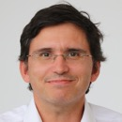
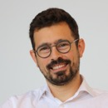
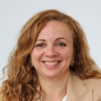
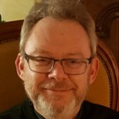
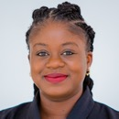
A high-level senior team to support our clients on their strategic projects
Sébastien
Frendo
DWDG Founder and Executive Director
Pierre
Catuli
Partner
Hind
guedira
Associate Partner, Education Director
CECILE
MAURISSET
Associate Partner
Director of Strategy- Tony Blair Institute
BCG
Telecom Paris
PLD, Harvard Business School
BCG
HEC Paris
Sciences Po
International Development Director, Louvre Hotels
Bain & Company
HEC Paris
McKinsey
Growth manager Genymobile
MSc Berkeley
Ponts & Chaussées
Michel
Forissier
Senior Advisor
Maela
Gozan
Senior Country Head
Ivory Coast and Togo
Fmr. Chief Engineering and Marketing Officer, Valeo
CEDEP, Ecole Centrale de Lyon
Country Head
Assistant Treasury Manager, NSIA Banque Togo
UQAM, Concordia University

Slide 10
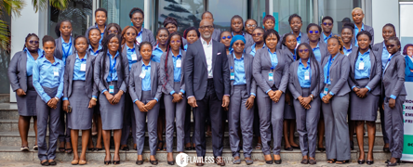
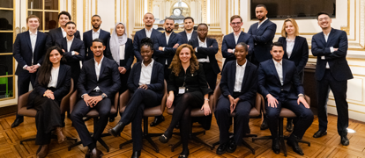
Focus on our Education programmes: we offer 3 in-person and 1 remote student programs to train the global leaders of tomorrow
EDUCATION
PPE
Presidential Program of Excellence
PEWA Program of Excellence for Women in Africa
PEEQ
Program of Excellence for Talent from Underprivileged background
Future Leaders Program
Offered to university students worldwide
2-year very selective program offered to top university students after which they join minister private office.
Currently offered in Togo under the patronage of the President Mr Faure Gnassingbé.
Every year 40 top young talents are being selected out of 3000 applications.
2-year very selective program offered to talented women in Africa and prepare for top jobs in the private sector and the administration.
Currently ran in Togo under the patronage of the Prime Minister Mrs Dogbé, and in Côte d'Ivoire with the patronage of the Prime Minister Mr Patrick Achi.
Launch in Rwanda in 2024.
18-month very selective program offered to talents coming from underprivileged background to prepare for highly-qualified jobs.
2 cohorts in Paris ("Programme d'Excellence pour les Elites de nos Quartiers)
Corporate partners are: Saint-Gobain, Hermès, BNP Paribas, Valeo, Enedis, Groupe VYV, Bpifrance, Engie
12 weeks for juniors and 10 weeks for senior students from over 100 universities worldwide, students go through series of intensive trainings.
Currently 2,500 students and 3,000 alumni in more than 40 countries, with incoming partnership with new universities, including top-tier ranked universities.

Slide 11
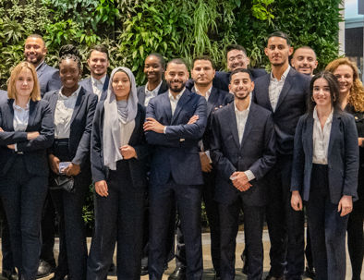
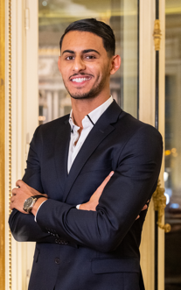
PEEQ: Program of Excellence for Talent from Underprivileged background
EDUCATION
Trains young future leaders from underprivileged background during their 1st year of Masters, highly selective (20 students per cohort out of 600 applicants)
Part-time 40 weeks of training, complementary to the university syllabus, followed by a 6-month internship in a partner company during their 2nd year of Masters (e.g., corporate strategy, consulting, sustainable development)
A unique program covering all the recruitment value chain, positioning people for a career of excellence
Focuses on skills for fast-paced corporate jobs like corporate strategy, problem-solving, critical thinking, company codes behavior and project management provided by Do Well Do Good strategy consultants
Pedagogy focused on personalized learning and learning by doing with real-world business cases, and coaching by former Harvard teachers
A program sponsored by corporate partners and free for students. Partners are: Saint-Gobain, Hermès, BNP Paribas, Valeo, Enedis, Groupe VYV, Bpifrance, Engie

